Slide 1
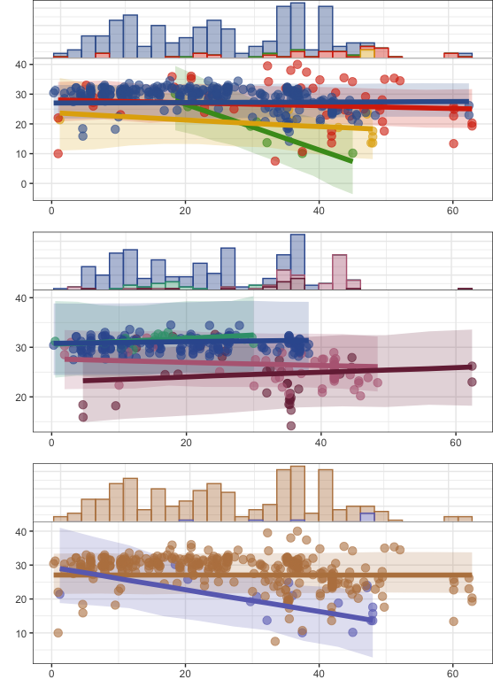
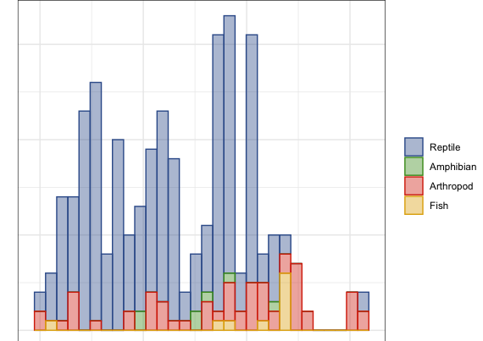
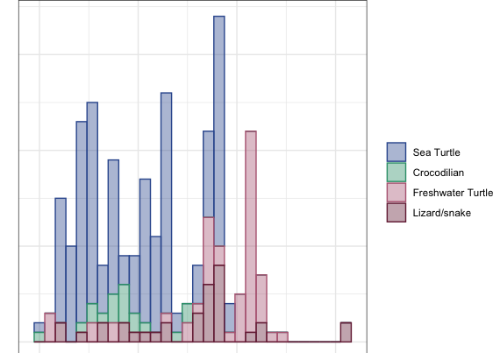
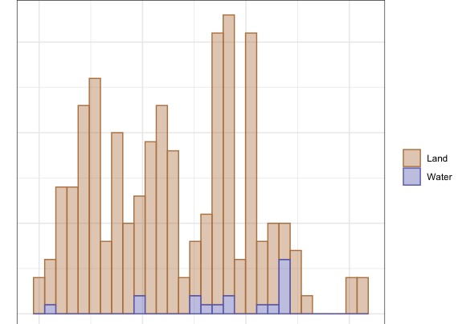
A
B
Mean temperature (C °)
C
Absolute latitude (degrees)

Slide 2
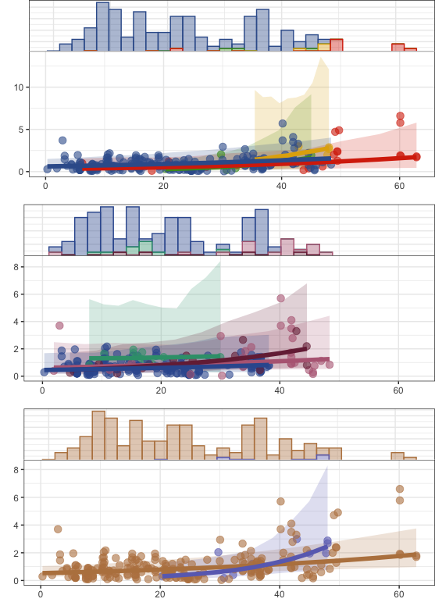
A
B
Standard deviation among site(C °)
C
Absolute latitude (degrees)

Slide 3
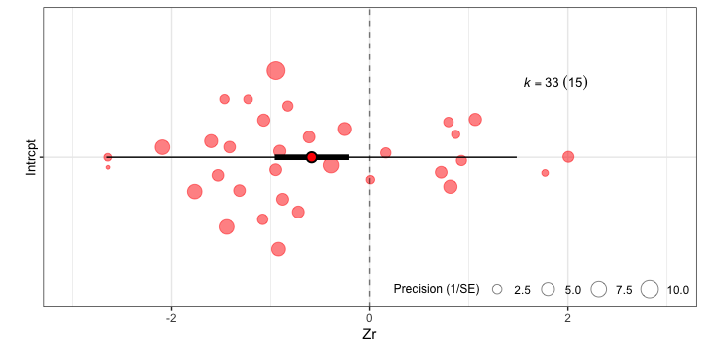
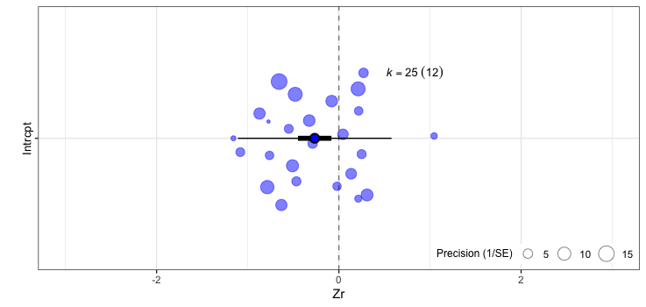
Incubation
duration
Survival

Slide 4
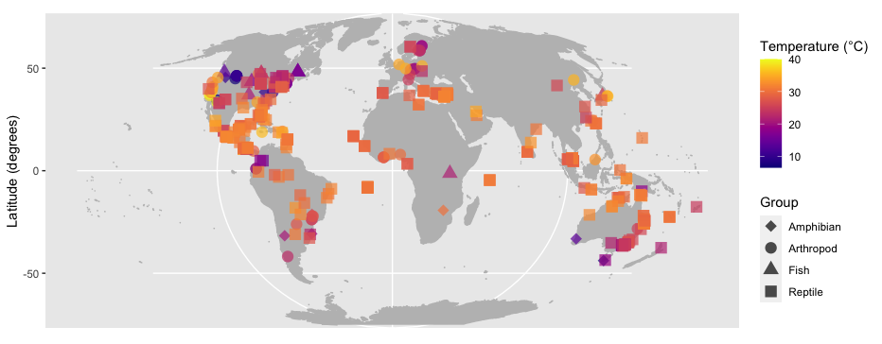
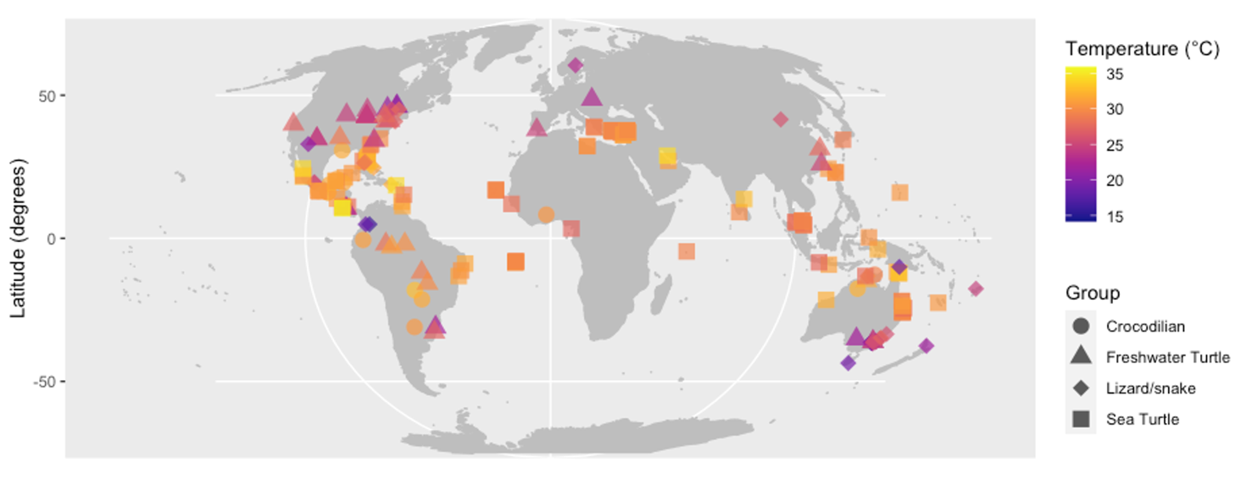
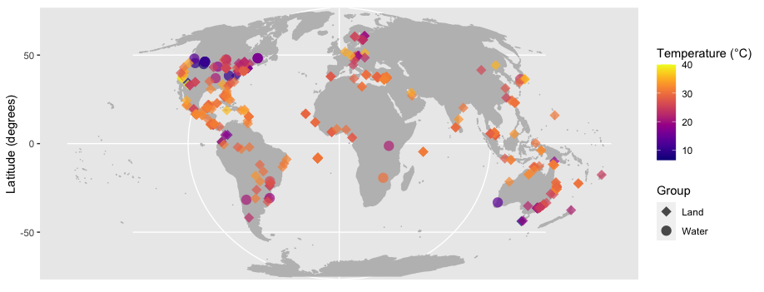
A
B
C

Slide 6
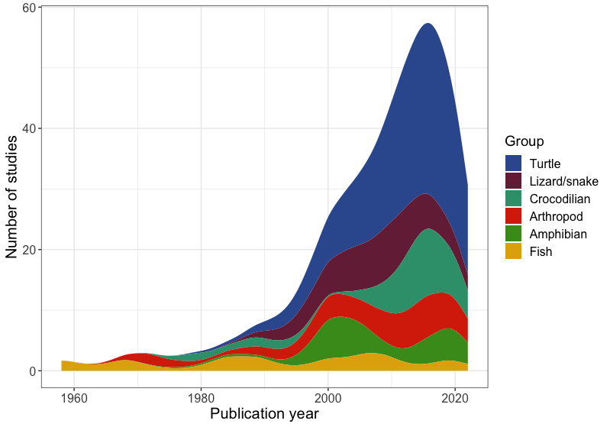
2
1

Slide 7
A. Ectotherms
Topics
B. Arthropods
C. Lizards, snakes and
freshwater turtles
D. Sea Turtles

Slide 8
A. Ectotherms
Group
B. Arthropods
C. Lizards, snakes and
freshwater turtles
D. Sea Turtles

Slide 9
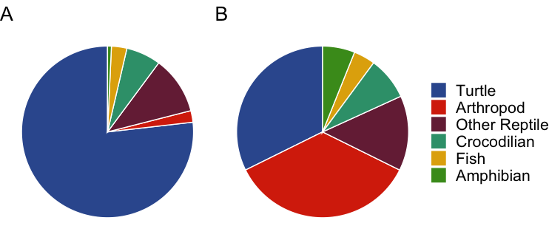
Group
Turtle
Arthropod
Lizard/snake
Crocodilian
Fish
Amphibian

